Slide 1
Deferred Shading
Let’s complicate things we already understand

Slide 2
Forward Rendering Review
“Forward” or “direct” rendering is the general approach to rendering you have been exposed to so far
Two common approaches to lighting/shading for forward renderers
Single pass lighting
Multipass lighting

Slide 3
Forward Rendering Review
Single pass lighting
Render the mesh once
Find some set of the lights affecting the object
Calculate lighting for up to some maximum number of lights (usually 8)
Limited by the number of variables you can pass from vertex to fragment shader for per-pixel lighting
Using shaders you still want to avoid looping through very many lights in one shader
Benefits
Geometry is transformed once

Slide 4
Forward Rendering Review
Single pass lighting
Drawbacks
Shader needs to handle all possible light types
Branching and increasing instruction count
Shadowmaps for all active lights must be loaded
Increasing memory footprint
Different materials and effects may require separate shaders that re-implement all of the above
Normal mapping
Skinning
Normal mapping + Skinning
“Uber shaders”
Restricted to a fixed maximum number of lights on object
Overdraw
Spend lots of time lighting a pixel just to have it replaced by a closer one

Slide 5
Forward Rendering Review
Multipass lighting
For each light
Render each mesh in light
Additively blend results to the frame buffer
Benefits
No longer restricted to a maximum number of lights
Shader results can be combined through blending to achieve various effects
Shaders are smaller, simpler
+
=

Slide 6
Forward Rendering Review
Multipass lighting
Drawbacks
Lots of repeated work
Geometry is transformed each pass
Lighting may result in nothing added for certain fragments
Texture filtering work may be repeated
Overdraw
Lots of context switching
Batching becomes difficult and complex
Worst case number of passes
Number of Objects * Number of Lights

Slide 7
Deferred Shading
Deferred method
For each mesh
Render mesh fragment properties to various buffers
Depth
-----------------------------------------------------------
Normal
Diffuse color (unlit texture, “Albedo”)
Material specular properties
Room for one more buffer if needed
No lighting calculations! (Yet)
For each light
Render some geometry to represent the light
Perform lighting for the necessary fragments inside the shape of the light

Slide 8
Deferred Shading
Deferred method
Benefits
Not restricted to a maximum number of lights
Adding lots of lights has a much smaller impact on FPS
No overdraw
Expensive lighting equations are performed only for fragments that will necessarily be visible
Simplified shaders
Each light has a shader for its light type
Material properties are stored in buffers
Geometry is transformed once/twice
Compare to multipass where geometry is transformed once per light on the object
Worst case number of passes
Number of objects + Number of lights

Slide 9
Deferred Shading
Drawbacks
Memory footprint
Four offscreen buffers at 32bits per pixel each
Same dimensions as framebuffer
At 1280x1024 = Almost 20MB of video memory
Packing/Unpacking data
Normal -> Color
Color -> Normal
Multisample Anti-Aliasing not 100% supported
Transparency doesn’t work in deferred
But we can still have it…

Slide 10
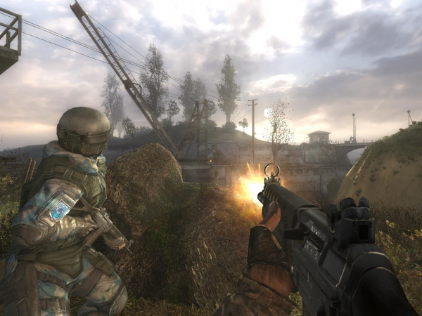
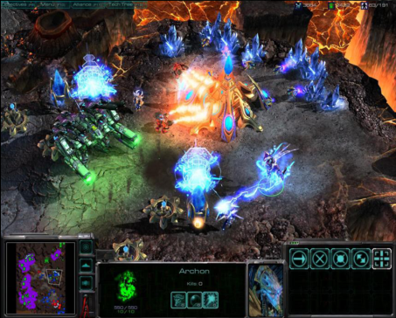
Deferred Shading
S.T.A.L.K.E.R.
Killzone 2
Starcraft 2

Slide 11
Deferred Shading
Three major stages
Polygon/Geometry Stage
This is really two stages in itself, Depth pass, then the rest
Lighting Stage
Post-Processing Stage

Slide 12
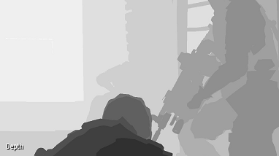
Deferred Shading
Polygon/Geometry Stage
Render Initial Depth Pass
Lets us skip over unnecessary fragments in the future
This will be a very simple shader and a cheap pass.
Notes:
We have overdraw at this point

Slide 13
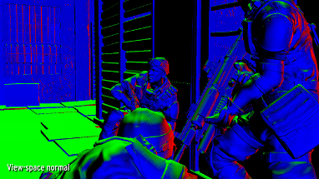
Deferred Shading
Polygon/Geometry Stage
Render Initial Depth
Render Surface Attributes (LEQUAL depth test)
Normal
Notes:
No overdraw during these phases

Slide 14
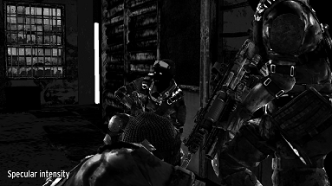
Deferred Shading
Polygon/Geometry Stage
Render Initial Depth
Render Surface Attributes
Normal
Material Specular Intensity/Power

Slide 15
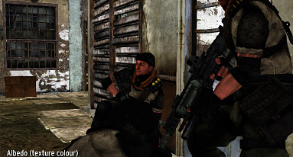
Deferred Shading
Polygon/Geometry Stage
Render Initial Depth
Render Surface Attributes
Normal
Material Specular Intensity/Power
Diffuse (unlit texture, “Albedo”)

Slide 16
Deferred Shading
Polygon/Geometry Stage
With Multiple Render Target (MRT) support all three of these buffers can be filled in one pass
On the downside, MRT currently requires that all render targets have the same bit depth
32bits for each pixel in each target

Slide 17
Deferred Shading
Polygon/Geometry Stage
How those bits are distributed/used per pixel tends to vary from implementation to implementation
Ex: ARGB8 for all buffers
8 bit for Normal.X, 8 for Normal.Y, 8 for Normal.Z, 8 null
8 bit for Diffuse.R, 8 for Diffuse.G, 8 for Diffuse.B, 8 null
8 bit for Spec.R, 8 for Spec.G, 8 for Spec.B, 8 SpecPower
32 bit depth buffer

Slide 18
Deferred Shading
Polygon/Geometry Stage
Precision may become an issue when packing normals
Some implementations choose different channel formats for storing normals
16 bit for Normal.X, 16 bit for Normal.Y
Higher precision, but more expensive to unpack
Normal.Z = sqrt(Normal.X^2 – Normal.Y^2)
A2RGB10
Somewhat better precision than 8bit
Notes:
We will be using a A2R10G10B10 or A2B10G10R10 format when we want increased precision as it is far simpler to implement and gives fine results.

Slide 19
Deferred Shading
Polygon/Geometry Stage
In unison, these 4 buffers (Depth, Normal, Diffuse, Specular) are commonly referred to as a “Geometry Buffer”
G-Buffer
Note that we don’t store fragment position
But position is needed for lighting!

Slide 20
Deferred Shading
Polygon/Geometry Stage
When we get to the lighting stage, we will calculate the world space position of each fragment from depth and other values
Normals in the normal buffer will need to be stored as all positive values
Float4 norm = normalize(inVert.normal) * .5 + .5

Slide 21
Deferred Shading
Polygon/Geometry Stage
Diffuse (texture), Specular intensity and Specular Power (shininess) often written to appropriate buffers without change
These two can cause the need for more than one shader solution to support complex multi-texturing or lack of specular map data.
This stage is now complete

Slide 22
Deferred Shading
Lighting Stage
General approach
G-Buffer now has the necessary data to calculate lighting in every fragment
For each light in view, we need to calculate lighting for every fragment it effects
We then additively blend the results into the framebuffer
+
=

Slide 23
Deferred Shading
Lighting Stage
Determining which fragments to light for a specific light source can be tricky, but various methods have been successfully implemented

Slide 24
Deferred Shading
Lighting Stage
Exhaustive, brute force approach
For each light in view, render a full screen quad
For each fragment in the quad
Calculate lighting for the equivalent fragment in the G-Buffer
Let the lighting equation decide what contribution this fragment gets from this light, if any
Normal dot LightVector
Attenuation
Etc
Additively blend the results into the frame buffer
If a fragment goes unlit by this light, we will just be adding zero and no change will occur
This is the only approach that makes sense for directional lights.
Notes:
Directional lights do not have attenuation so all fragments that face the light at all will receive lighting. There is no volume of light area defined by a directional light, unlike a point light (sphere) or spot light (cone).

Slide 25
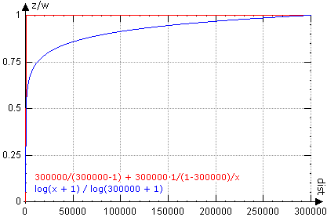
Deferred Shading
Lighting Stage
Calculating fragment position
We have fragment depth
Depth values not linearly distributed
0.0 to 1.0 range
Most of this range is reserved for close to near plane
Seriously, almost all of that range is very close to the near clip plane.

Slide 26
Deferred Shading
Lighting Stage
Calculating fragment position
We will render a full screen quad in clip space.
Make sure to pass position to fragment shader.
The position passed to fragment shader will have the correct X and Y components for the fragment but not Z, in clip space. Good thing we wrote out those depth values.
Multiply this clip space position by the inverse concatenation of the view and projection matrix to get world space position.
Notes:
This is the easy way, not always the best way. The best way is likely to keep everything in view space to do calculations and avoid the matrix multiply per fragment.

Slide 27

Deferred Shading
Lighting Stage
You could find the “gInvViewProj” matrix in your fragment shader by multiplying the view and projection matrices then calling inverse.
Is there an HLSL inverse? Don’t find out.
Only do it this way if you want to have super slow rendering and be made fun of.
The right way is to do the multiply and inverse CPU side once and store it is as a shared shader parameter, only passing it once each frame.

Slide 28
Deferred Shading
Lighting Stage
We now have the necessary info to light this fragment
World space normal from normal buffer
World space light direction
Surface specular properties
Light properties (color, atten., pos., etc.) pass to shader
Calculate the lighting and additively blend to framebuffer

Slide 29
Deferred Shading
Lighting Stage
Currently doing unnecessary work
For every light in view…
For every fragment…
Calculate lighting
For most lights only a portion of all fragments will be noticeably lit
If we can cull out unlit fragments then we can reduce the number of lighting calculations we do for each light
This is how we get to say things like, “I can render as many lights as I like, with little or no consequence.“

Slide 30
Deferred Shading
Lighting Stage
Scissor test
Scissor tests let us designate rectangular areas where fragment operations will/will not be executed
Calculate a 2D screen space box that bounds your current light
Use the scissor test to only do lighting on the fragments in this box

Slide 31
Deferred Shading
Lighting Stage
Scissor Test limitations
2D, screen space culling
Fragments that represent points in front/behind light are not culled and wasted calculations are still done
A box is also not a tight bounding volume in most cases

Slide 32
Deferred Shading
Lighting Stage
Light bounding volumes
3D convex geometry that represents bounds of light
Spheres for point lights, Cones for spot lights
Render the volume and only the fragments in the light volume will be rendered, sort of.
Rendering a billion lights that do not overlap cost the same as one light that fits everything.

Slide 33
Deferred Shading
Lighting Stage
Light bounding volumes
Tighter fit, but still 2D
Fragments that represent points in front/behind light are not culled and wasted calculations are still done
With creative use of the depth buffer (from G-Buffer) we can actually turn this into a 3D test and discard undesired fragments

Slide 34
Deferred Shading
Lighting Stage
Light bounding volumes
3D involves multiple passes for each light to calculate stencil values
Render back faces of volume (only to stencil)
Depth test Greater-Equal
Any fragments in front of the back of the light will be stenciled

Slide 35
Deferred Shading
Lighting Stage
Light bounding volumes
3D involves multiple passes for each light to calculate stencil values
Render back faces of volume (only to stencil)
Depth test Greater-Equal
Any fragments in front of the back of the light will be stenciled

Slide 36
Deferred Shading
Lighting Stage
Light bounding volumes
3D involves multiple passes for each light to calculate stencil values
Render front faces of volume (only to stencil)
Depth test Less-Equal
Any fragments behind the front of the light will be stenciled

Slide 37
Deferred Shading
Lighting Stage
Light bounding volumes
Only perform lighting operations for fragments that passed both stencil tests

Slide 38
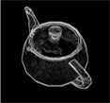
Deferred Shading
Post-Processing Stage
Optional, but often implemented
Clean up aliasing
Use a post-process edge-detection shader
Widely implemented for various effects like cell-shading
Often uses depth and normal differences to find edges
Once found, edges are blurred to remove “jaggies”

Slide 39
Deferred Shading
Transparencies
Transparent objects are usually rendered into the frame buffer after everything else, using a traditional forward renderer
Many implementations try to simplify this step by taking shortcuts like not drawing shadows for transparent objects

